Slide 1
TULANE GROUP UPDATE ON AUTOMATED TRAIT EXTRACTION
Bahadır Altıntaş
Yasin Bakış
Xiaojun Wang
Henry Bart Jr.

Slide 2
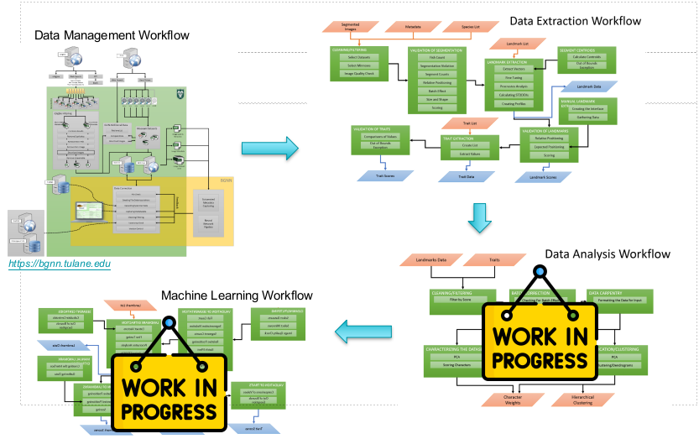
Workflow

Slide 3
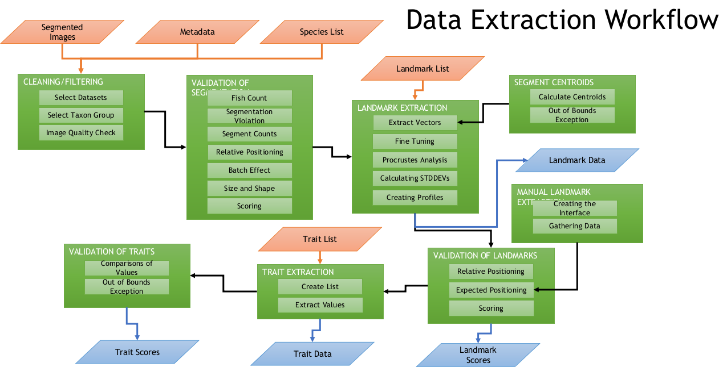
Our Workflow

Slide 4
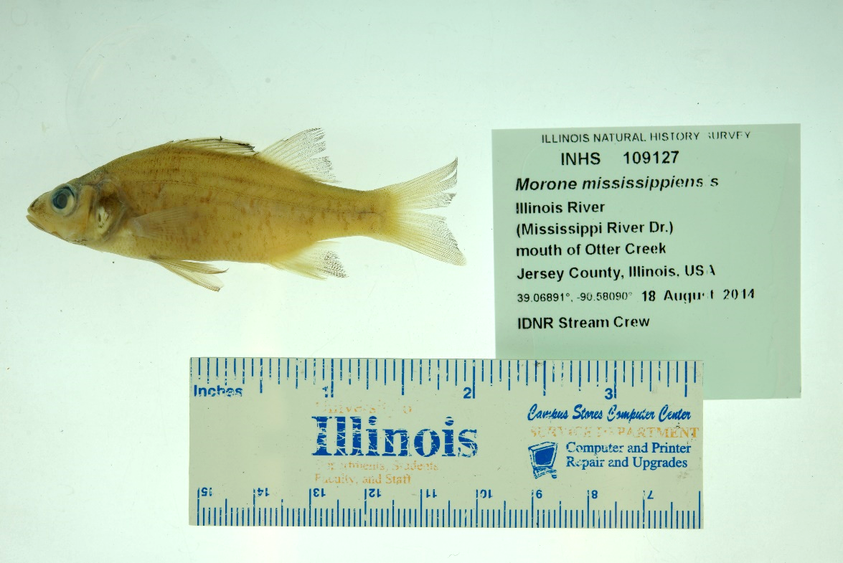
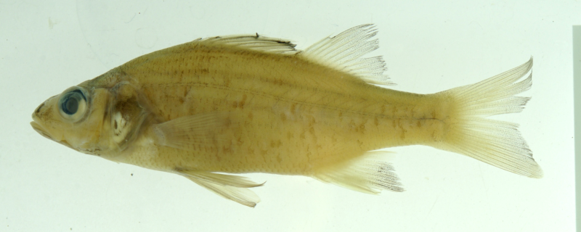
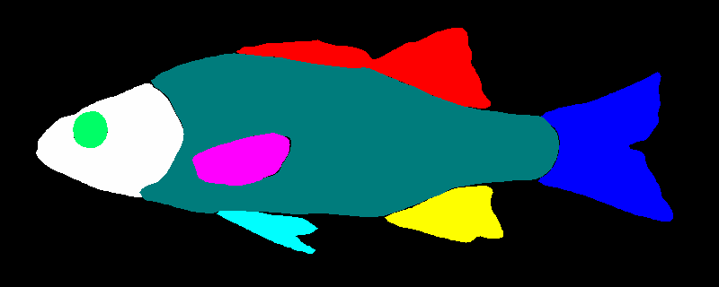
(OBJECT DETECTION)
BOUNDING BOXING
Karpatne Lab
Karpatne Lab
SEGMENTATION

Slide 5
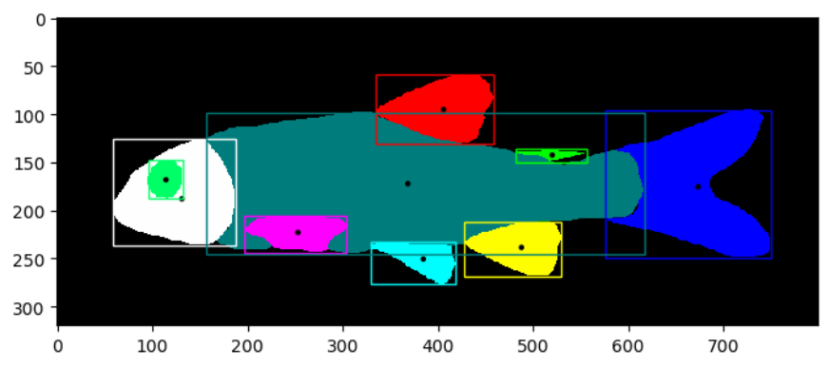
Centroids and Areas

Slide 6
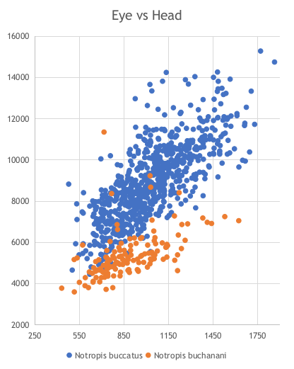
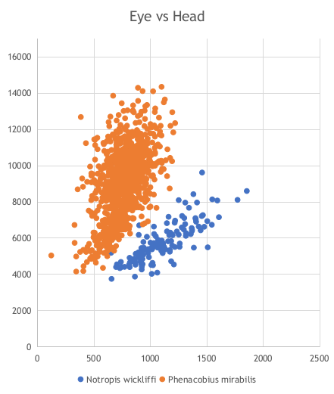
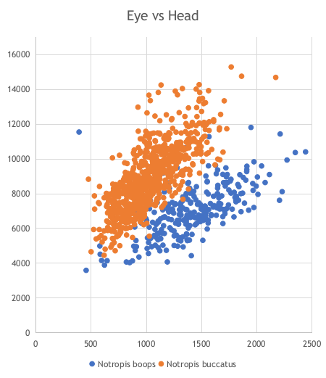
Area based trait discovery

Slide 7
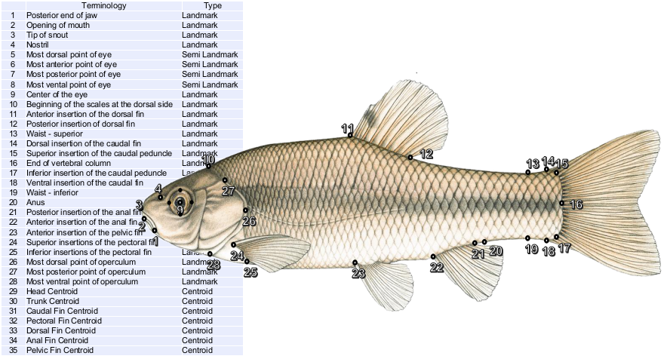
Landmarks

Slide 8
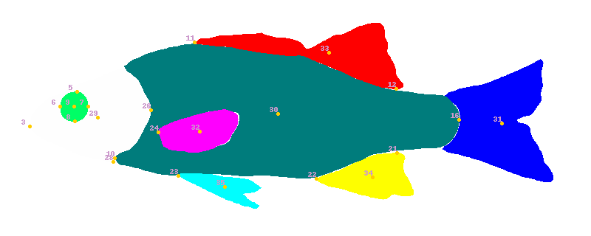
Landmarks
 | Terminology | Type
1 | Posterior end of jaw | Landmark
2 | Opening of mouth | Landmark
3 | Tip of snout | Landmark
4 | Nostril | Landmark
5 | Most dorsal point of eye | Semi Landmark
6 | Most anterior point of eye | Semi Landmark
7 | Most posterior point of eye | Semi Landmark
8 | Most vental point of eye | Semi Landmark
9 | Center of the eye | Landmark
10 | Beginning of the scales at the dorsal side | Landmark
11 | Anterior insertion of the dorsal fin | Landmark
12 | Posterior insertion of dorsal fin | Landmark
13 | Waist - superior | Landmark
14 | Dorsal insertion of the caudal fin | Landmark
15 | Superior insertion of the caudal peduncle | Landmark
16 | End of vertebral column | Landmark
17 | Inferior insertion of the caudal peduncle | Landmark
18 | Ventral insertion of the caudal fin | Landmark
19 | Waist - inferior | Landmark
20 | Anus | Landmark
21 | Posterior insertion of the anal fin | Landmark
22 | Anterior insertion of the anal fin | Landmark
23 | Anterior insertion of the pelvic fin | Landmark
24 | Superior insertions of the pectoral fin | Landmark
25 | Inferior insertions of the pectoral fin | Landmark
26 | Most dorsal point of operculum | Landmark
27 | Most posterior point of operculum | Landmark
28 | Most ventral point of operculum | Landmark
29 | Head Centroid | Centroid
30 | Trunk Centroid | Centroid
31 | Caudal Fin Centroid | Centroid
32 | Pectoral Fin Centroid | Centroid
33 | Dorsal Fin Centroid | Centroid
34 | Anal Fin Centroid | Centroid
35 | Pelvic Fin Centroid | Centroid
INHS : ~ 20K FMNH: ~2700 OSUM:~1500

Slide 9
POSSIBLE TRAITS
Trait name | Number of trait
Landmark(including centroids) | 35
Centroids | 7
Area of segment | 12
Trait type | Landmarks needed(min) | Number Of Traits
Distance | 2 | 595
Angle | 3 | 6545
Area | 3….n | ?????
Ratio | 2 | ????????

Slide 10
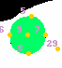
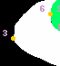
Problems with landmarking
Positioning of the Eye LMs
Tracing problem at Snout

Slide 11
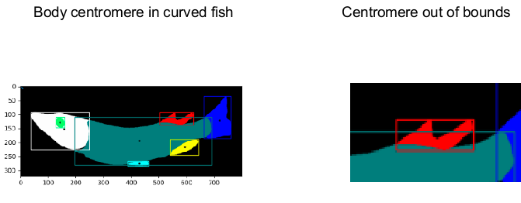
..more

Slide 12
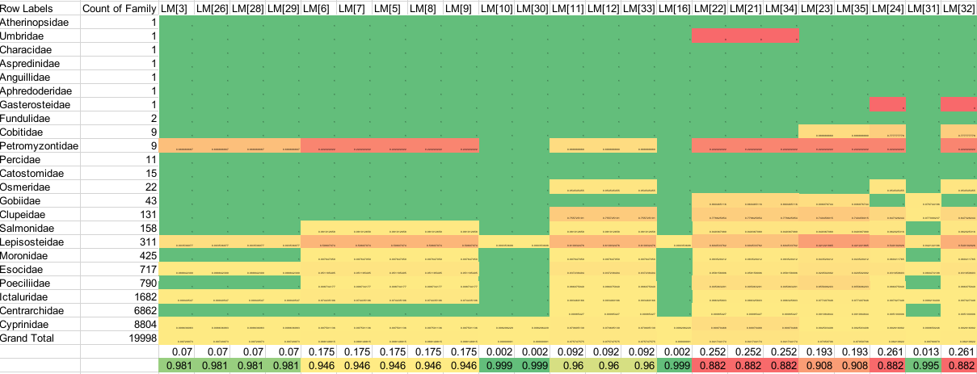
Success Rate
Heatmap based on success rate of families vs landmarks

Slide 13
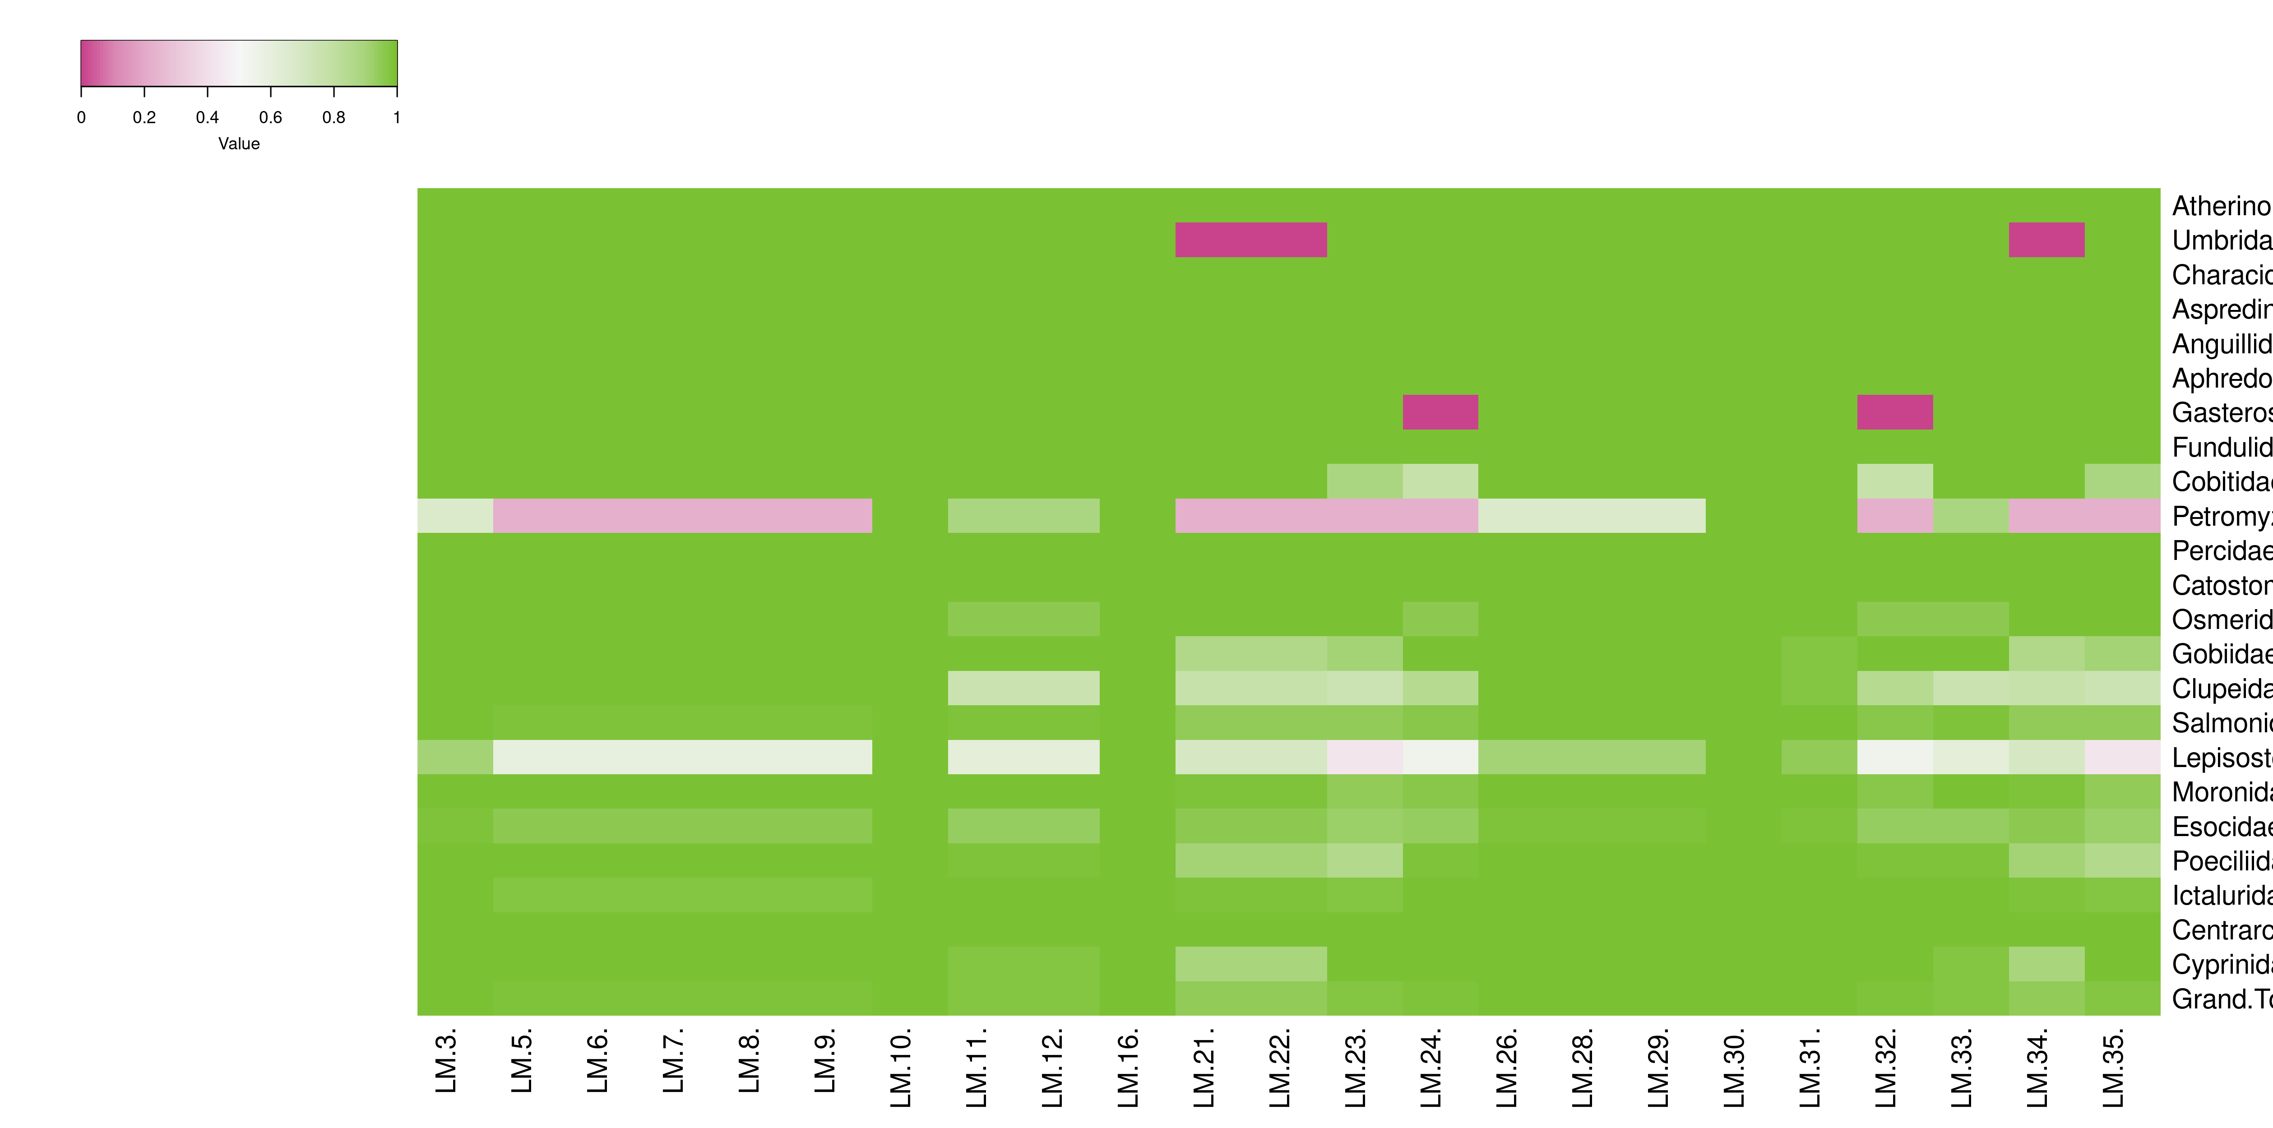
Success Rate
Heatmap based on success rate of families vs landmarks

Slide 14
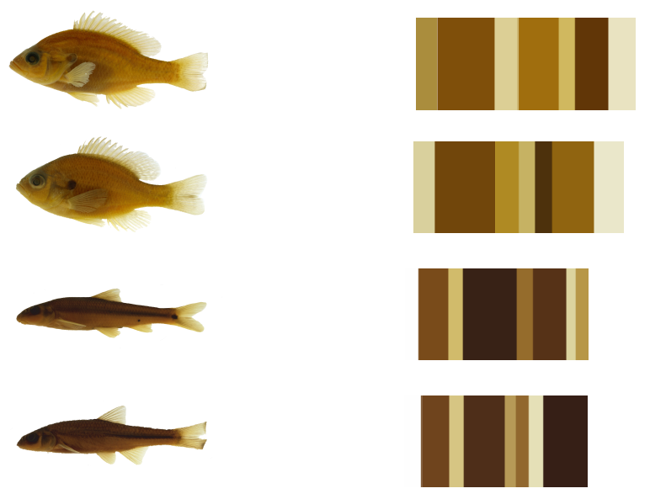
COLOR based data extraction

Slide 15
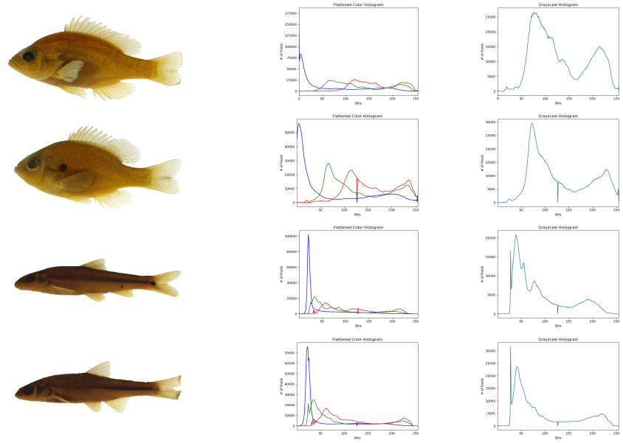
Histograms
Flattened color histogram
Grayscale histogram

Slide 16
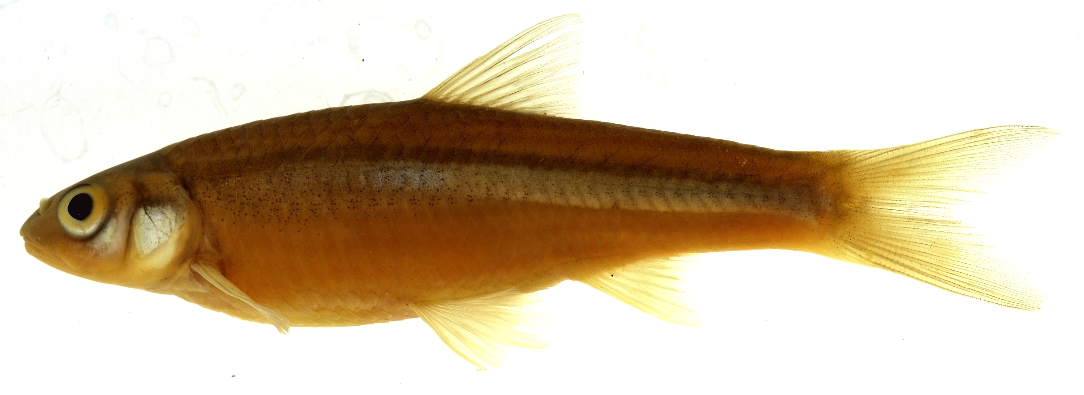
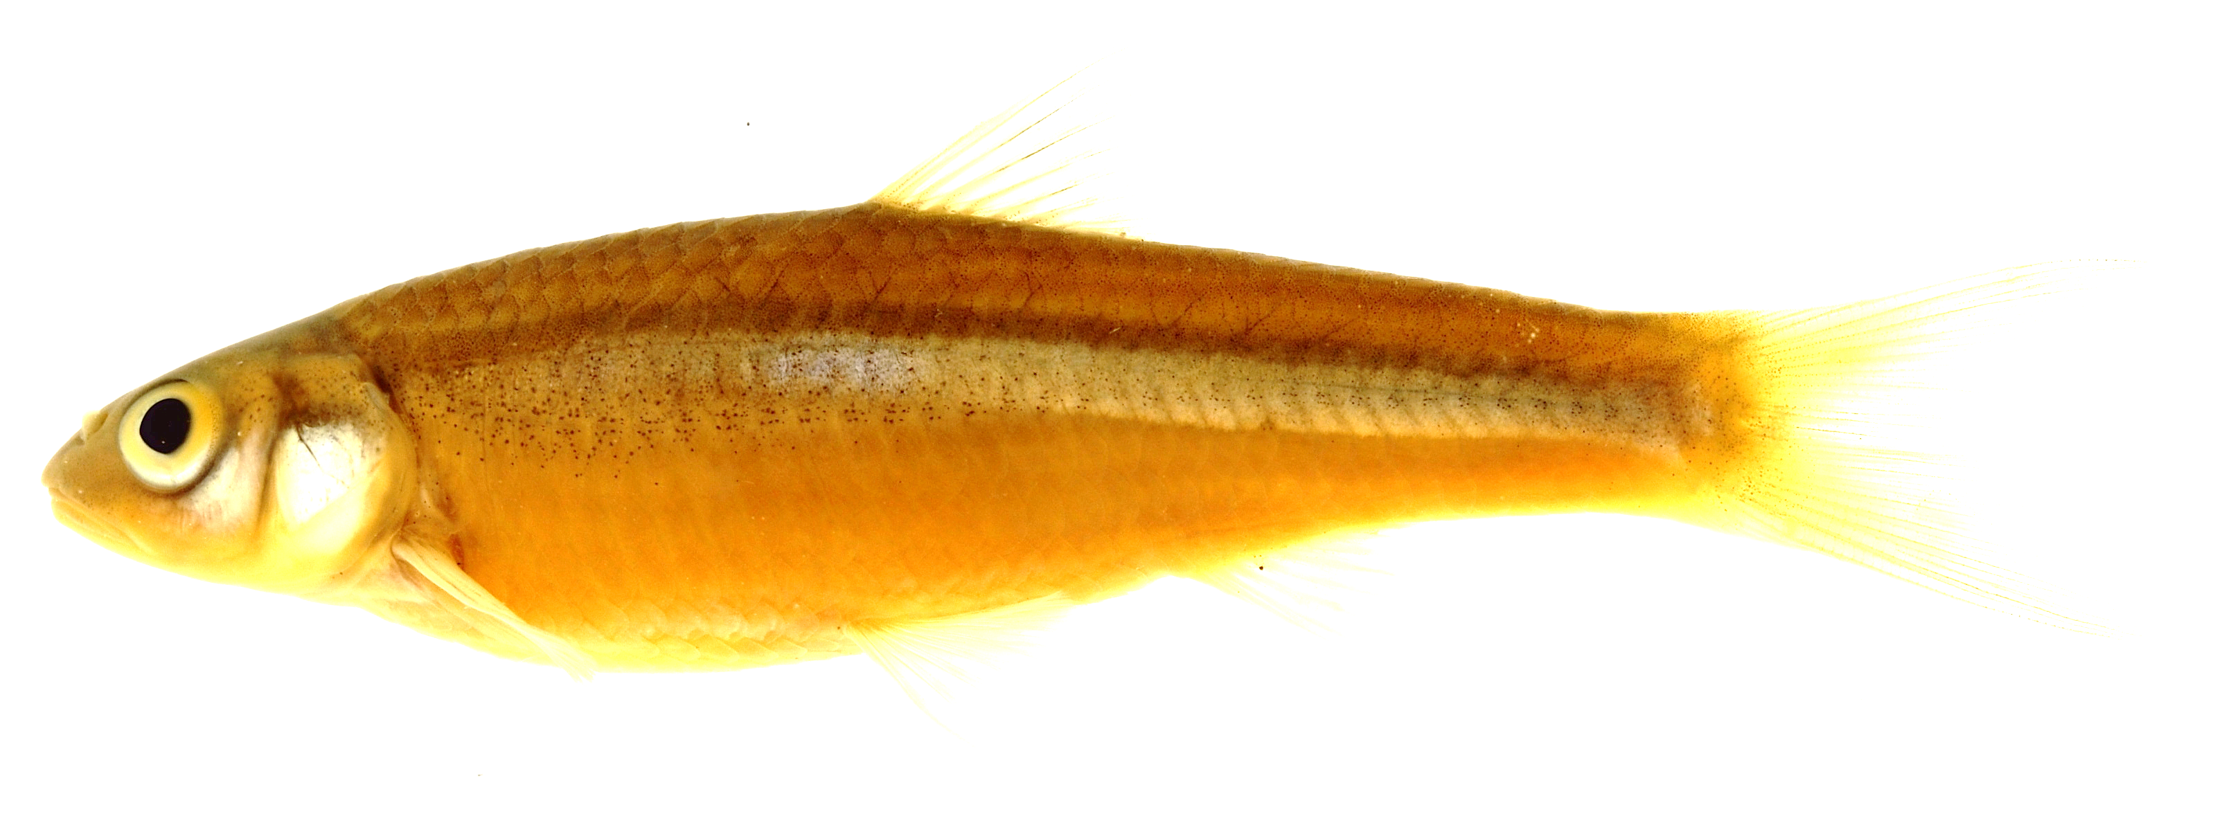
Future Work: Color pattern

Slide 17
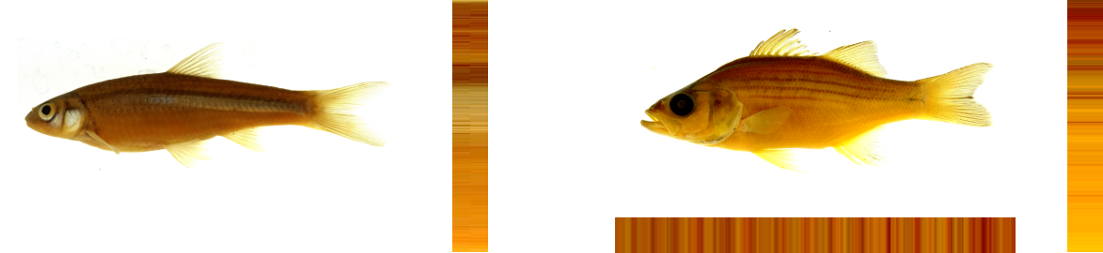
Future Work: Color pattern

Slide 18
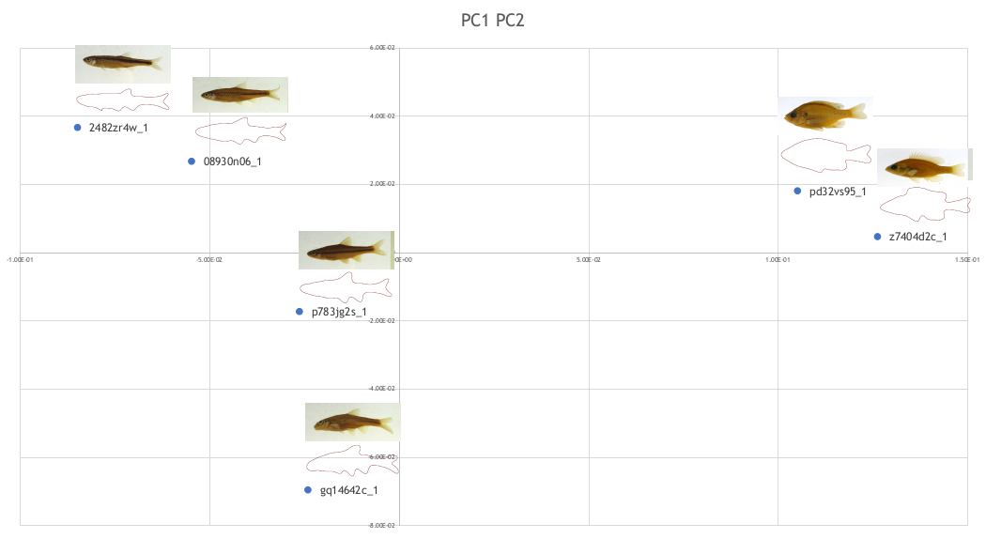
Future Work: Outline analysis

Slide 19
Credits
Virgina Tech group
Anuj
Maruf
Moe
Drexel Group
Jane
Joel
Kevin
https://github.com/tubri/bahadir_presentations/raw/main/11.07.20022_presentation_tubri.pptx

